Slide 1
Travel PLANNER AI agent
CAPSTONE PROJECT
Presented By: Rehan Mallick
Student name :Rehan Mallick
College Name & Department : Bapuji Institute Of Engineering And Technology & (Computer Science and Engineering )-CSE

Slide 2
OUTLINE
Problem Statement
Technology used
Wow factor
End users
Result
Conclusion
Future scope
IBM Certifications
GITHUB link

Slide 3
Problem Statement
Travel planning can be complex and time-consuming, with users overwhelmed by choices and real-time changes. A smart AI agent is needed to streamline trip planning and personalize itineraries based on preferences and constraints.
Proposed Solution: A conversational Travel Planner Agent, powered by IBM Cloud Lite and Granite, acts as your trip co-pilot—offering real-time suggestions, booking support, and itinerary optimization for a hassle-free, memorable journey..

Slide 4
Technology used
IBM Cloud Lite: For hosting and deploying the AI agent efficiently at zero or minimal cost.
IBM Granite Models: To power natural language understanding and generation for conversational capabilities
Watsonx.ai : For building, fine-tuning, and evaluating your AI models in a scalable, enterprise-ready environment.
NLP (Natural Language Processing) : enables the agent to understand, interpret, and respond to human language for personalized travel interactions.

Slide 5
IBM cloud services used
IBM Cloud Watsonx AI Studio
IBM Cloud Watsonx AI runtime
IBM Cloud Agent Lab
IBM Granite foundation model

Slide 6
Wow factors
The Travel Planner Agent transforms the traditionally fragmented process of trip planning into an intelligent and personalized experience. It uses AI to curate itineraries by integrating real-time data from maps, weather forecasts, and booking services. Built on IBM Granite and Watsonx.ai, the agent dynamically adapts to user preferences, constraints, and contextual changes. Its ability to manage recommendations, schedule adjustments, and bookings makes it a smart, end-to-end travel companion.interests.

Slide 7
End users
Individual travellers
Educational institutions and students
Corporate travel teams
Travel agencies

Slide 8
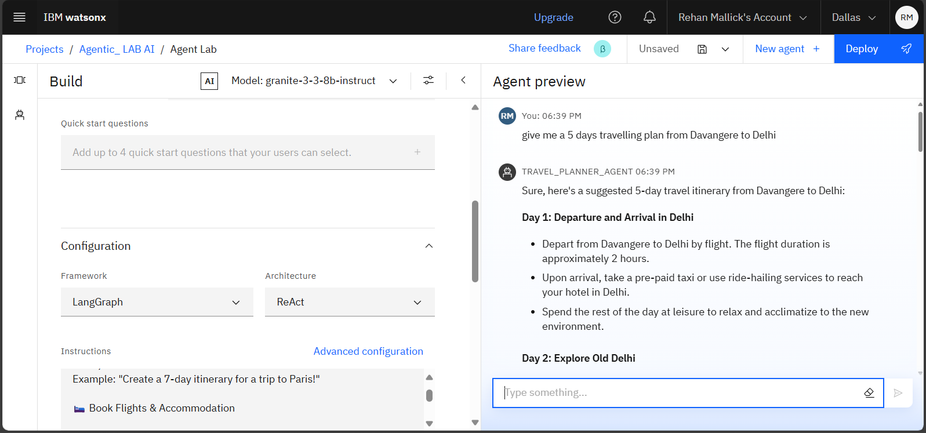
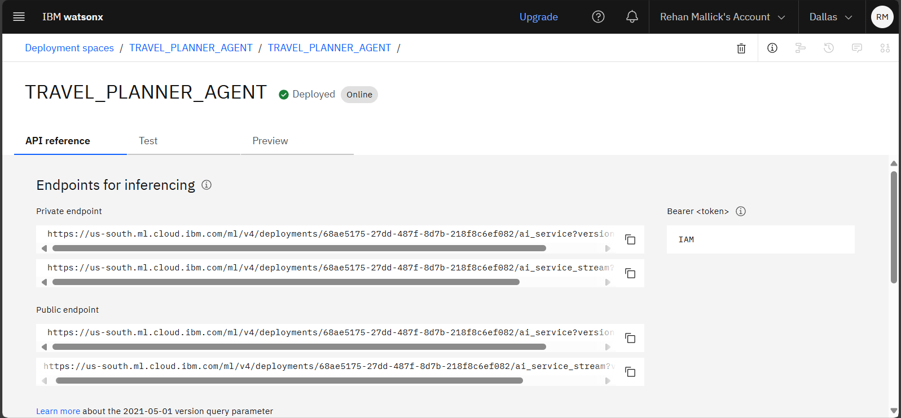
Results

Slide 9
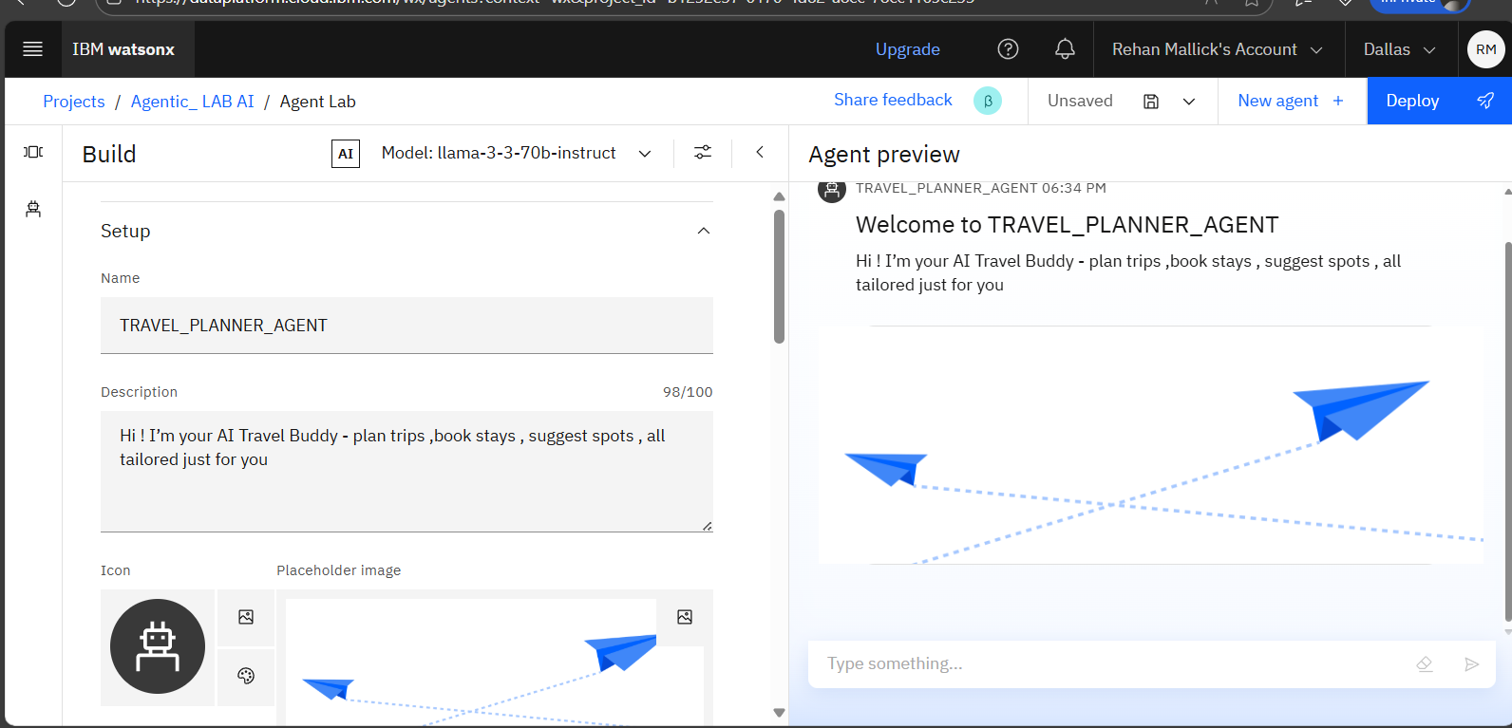
Results

Slide 10
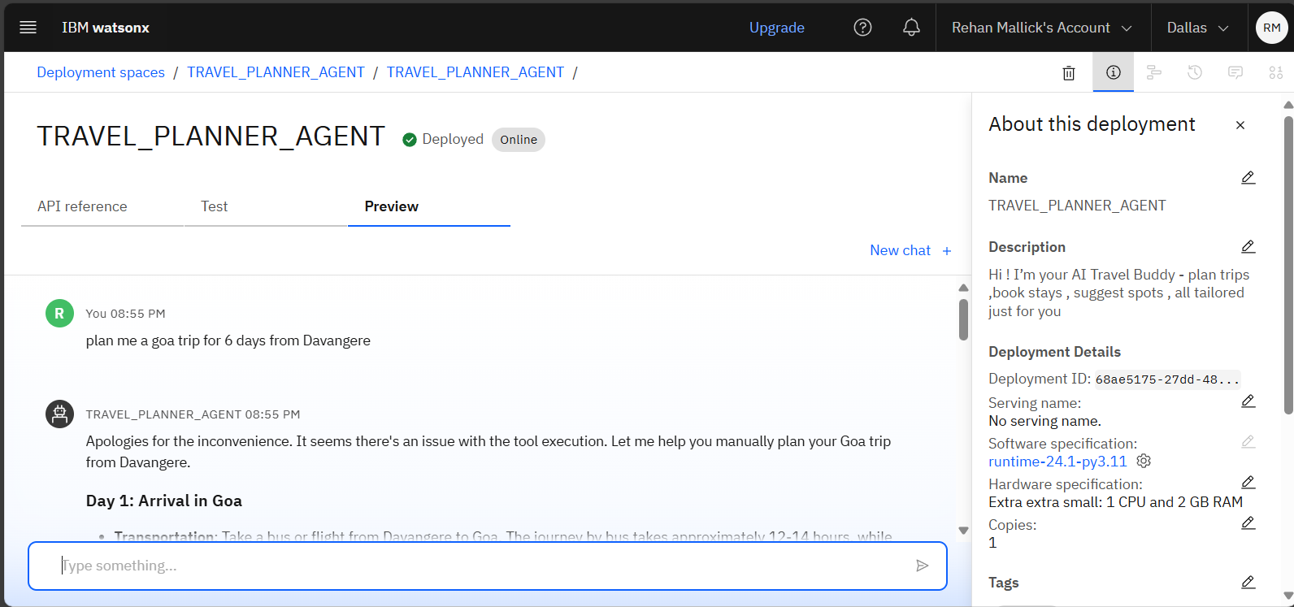
Results
Deployed AI Agent

Slide 11
Conclusion
Personalized Trip Planning The agent uses user preferences, budget, and constraints to generate customized travel itineraries, enhancing convenience and satisfaction
Real-Time Intelligence & Optimization By integrating IBM Granite and Cloud Lite, it delivers dynamic suggestions for transport, accommodations, and weather-aware scheduling.
Seamless Experience Management The system supports live booking updates, rescheduling, and alerts—transforming travel into a smooth, intelligent, and user-friendly journey.

Slide 12
Future scope
User Profiling and Preference
Real-Time Collaboration Features
Transport and Accommodation Integration
Conversational AI Interface
Retrieval-Augmented Generation (RAG)

Slide 13
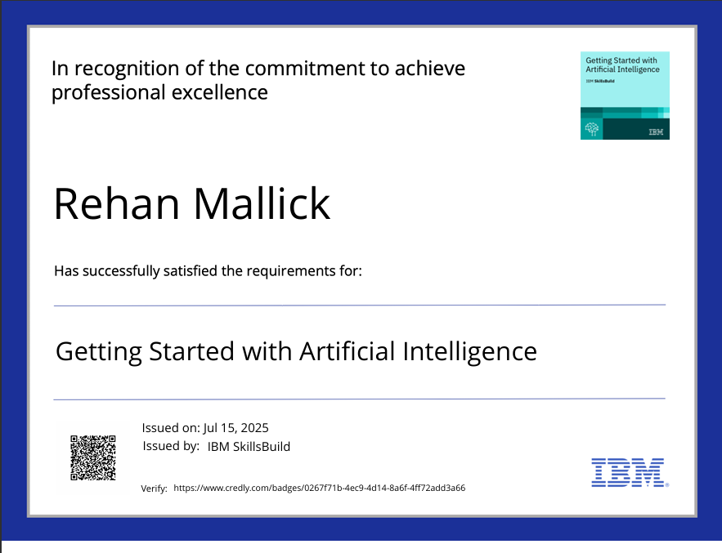
IBM Certifications
1. GETTING STARTED WITH AI CERIFICATION

Slide 14
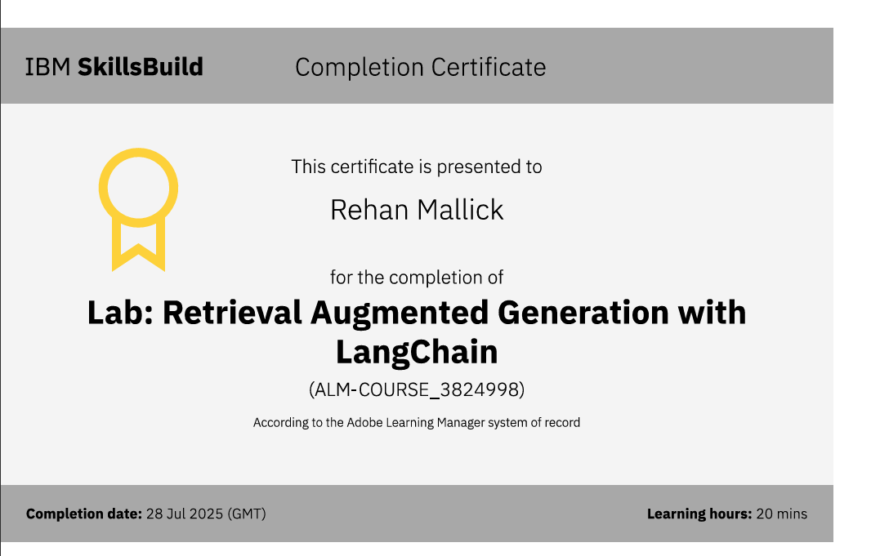
2. RAG LAB CERTIFICATE

Slide 15
GitHub Link
Github link - https://github.com/Rehan-Mallik/Travel-Planner-Agent

Slide 16
THANK YOU

